Slide 1
Lowndes WMA Pig project
Chapter 1: How to kill them
Chapter 2: How to cook them
JK: Deer and turkey response to pig removal

Slide 2
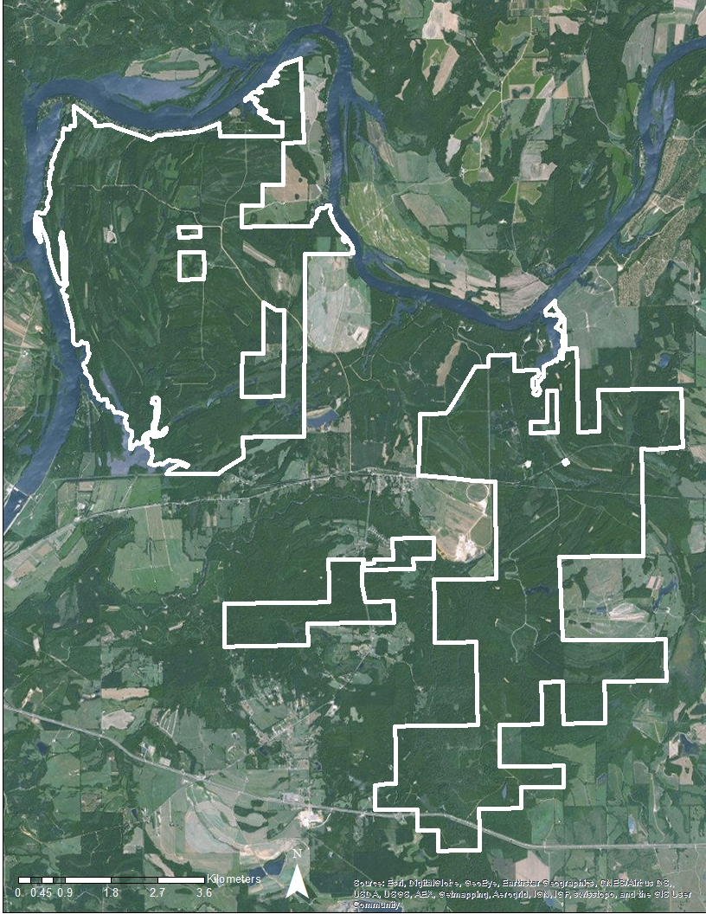
Chapter 1 Overview
Whole sounder removal
NW removed pigs
SE no removal

Slide 3
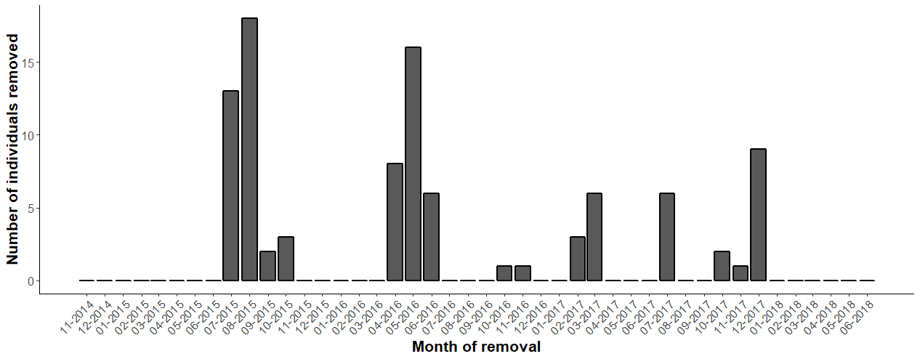
Removals

Slide 4
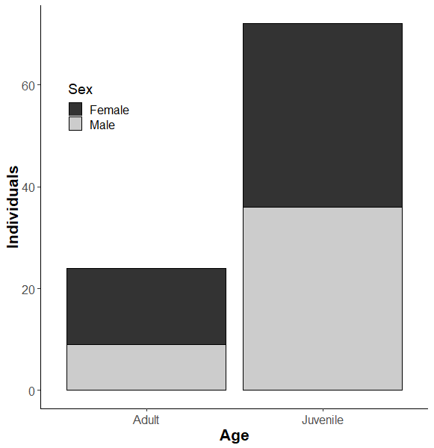
Removal demographics

Slide 5
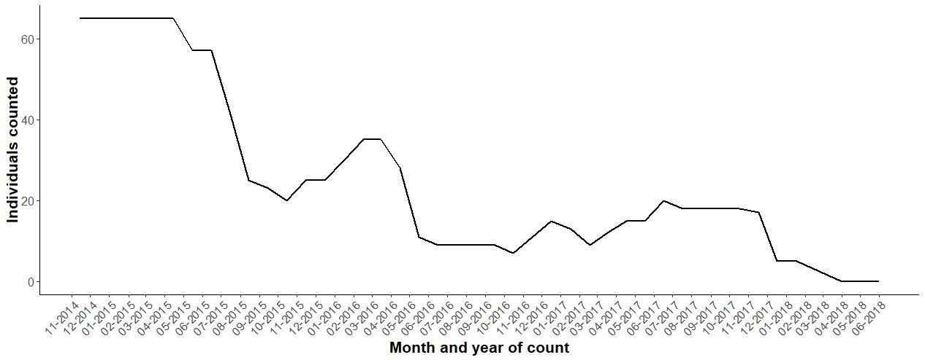
Counts

Slide 6
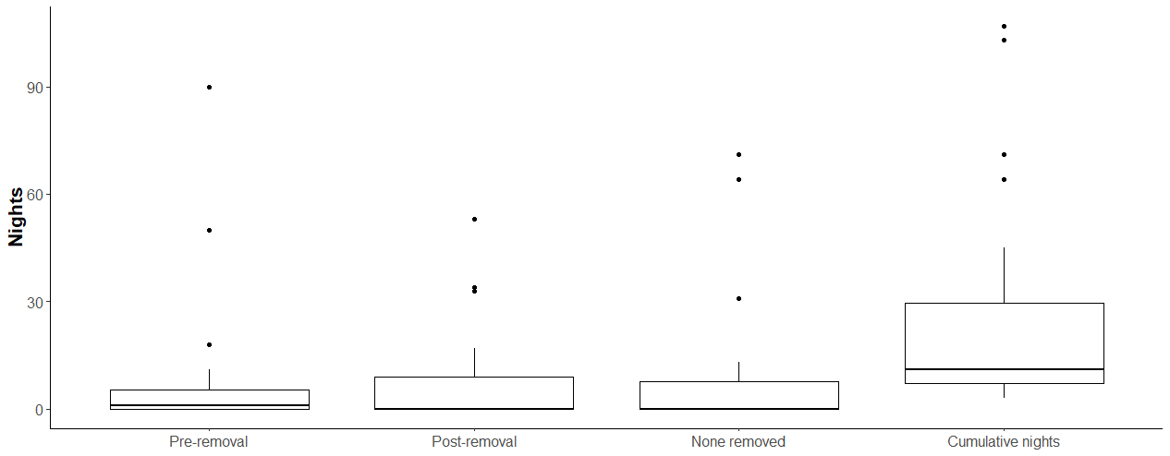
Effort

Slide 7
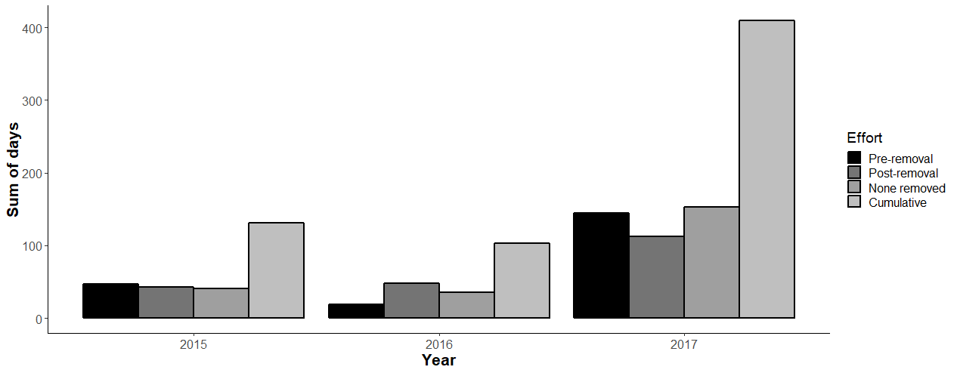
Effort by year

Slide 8
Chapter 2: deer and turkey
Do deer and turkey behave differently when pigs have been removed?
Do deer and turkey numbers respond after whole sounder removal?
1st step: test out methods of activity pattern and single species occupancy with preliminary survey

Slide 9
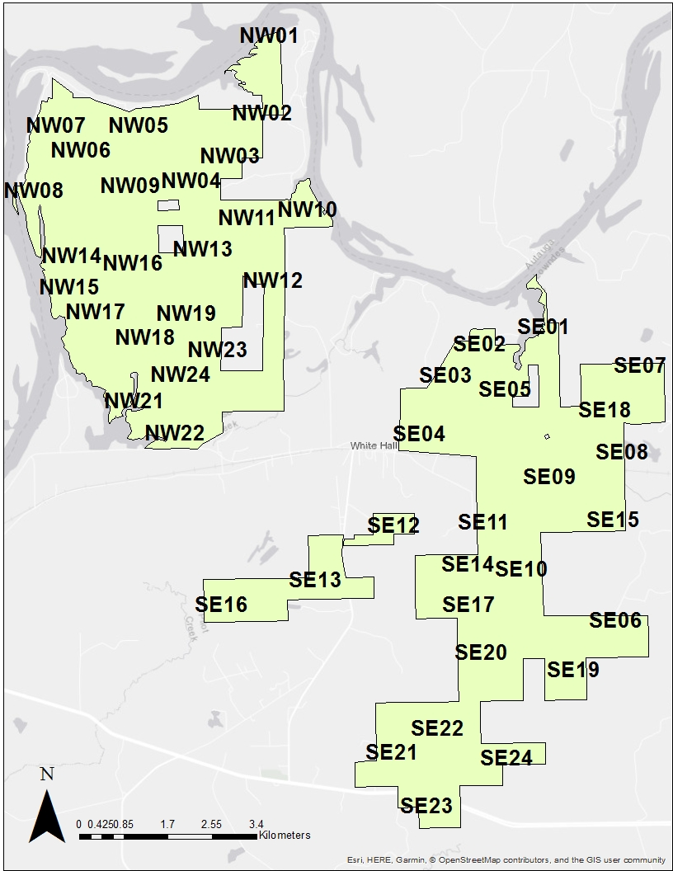
Pig survey Nov 2014
Pre-bait with corn 1 wk
Camera is out for 1 wk
6 24-hour periods of data
About 1 cam/km²
Placed in “piggy” areas
w/ pig sign or in wetland area

Slide 11
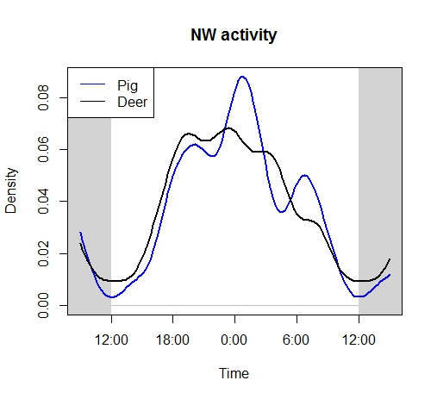
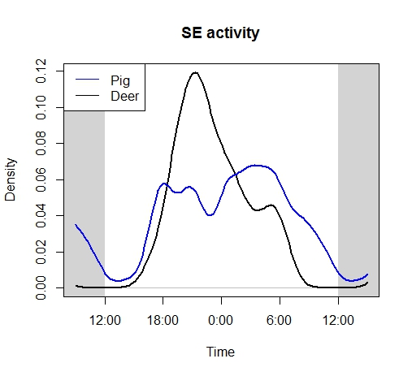
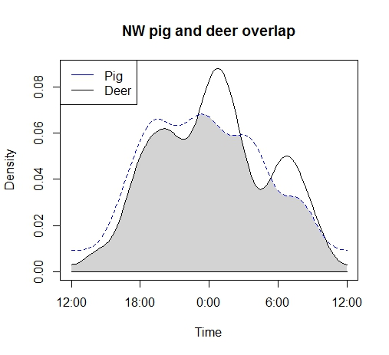
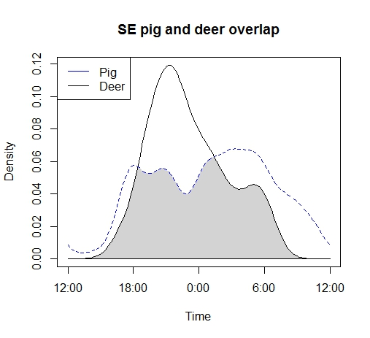
Using package ‘overlap’

Slide 12
Using unmarked single sp occu

Slide 13
Deer seem to care more about pigs than pigs care about deer

Slide 14
2nd step
Use surveys from WMA to answer questions about activity, occupancy, and abundance during/after sounder removal
Turkey surveys
July (1 camera/1 km²)
February/March (1 camera/4 km²)
Deer surveys
February/March and September (2.43 km dist)

Slide 15
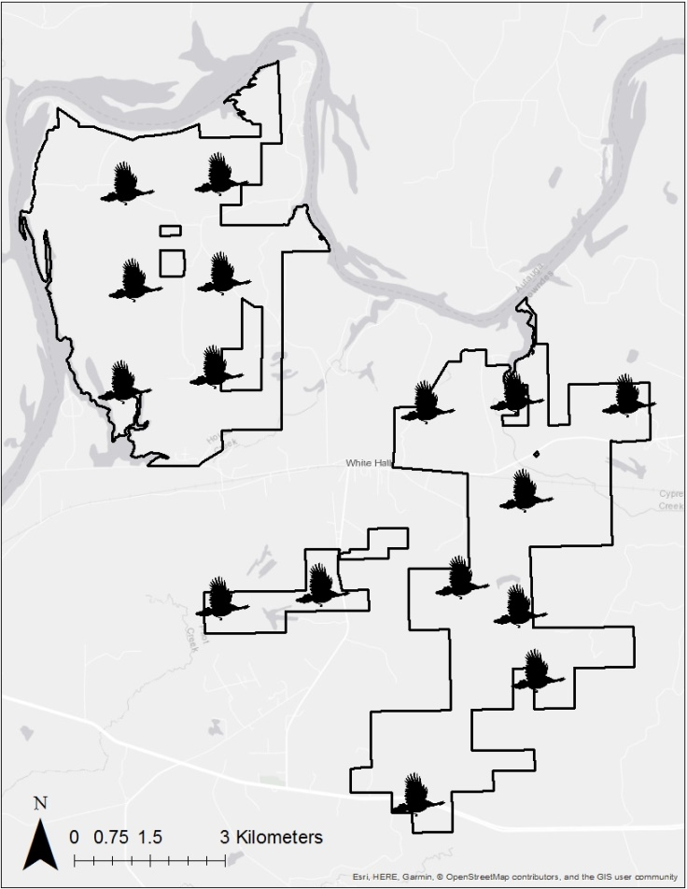
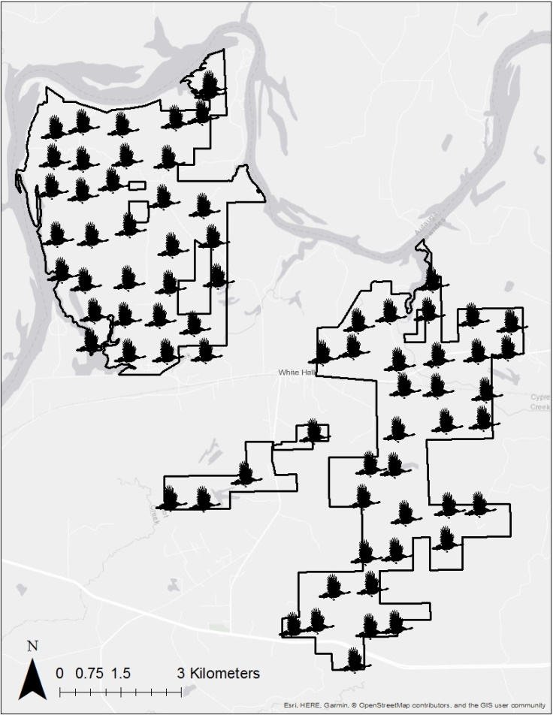
Turkey surveys Timelapse: every 5 min 9-11am; 4-8pm Trigger: 24 hrs, 3 pics/trigger
Feb/March 2015, 2016, 2017, 2018
July 2015, 2016, 2017

Slide 16
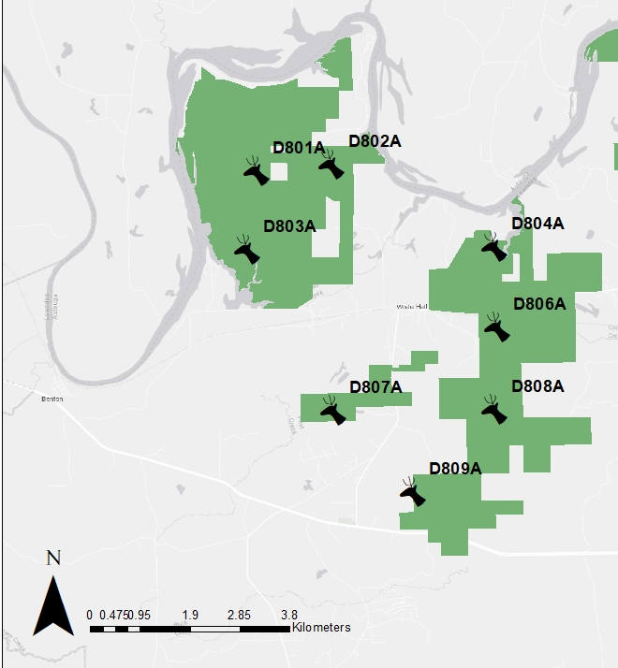
Deer surveys
Timelapse: every 5 min
Trigger: 3 pics/ trigger
Sep 2015
Feb & Sep 2016
Feb & Sep 2017
Feb 2018

Slide 17
# Images processed
Spring turkey surveys: 149,197 images
Summer turkey surveys: 371,476
Deer surveys: 134,925
Total: 655,598

Slide 18
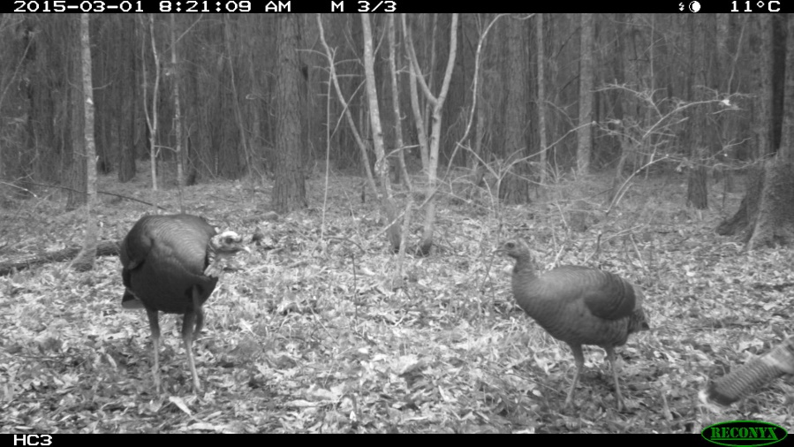
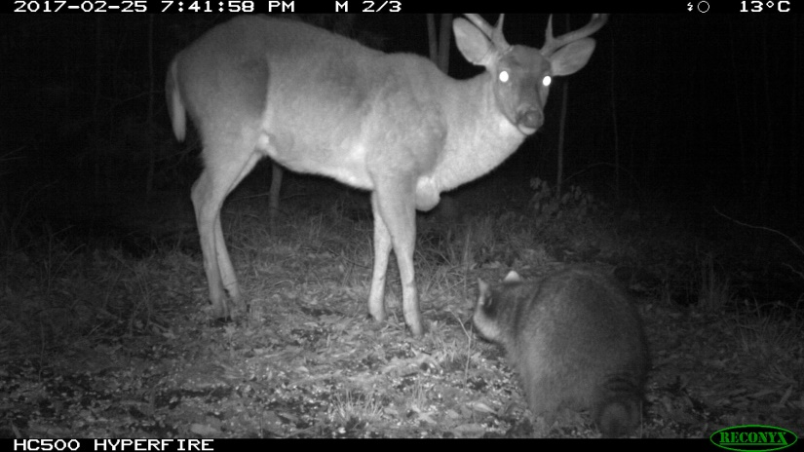
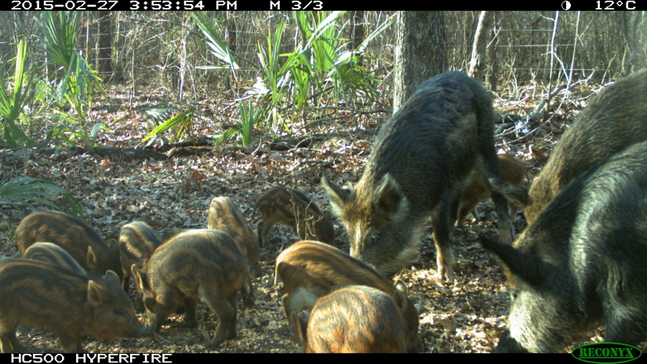
Classifications
Deer
Immature buck
branched
Mature buck
>= 3.5 yrs
branched
Doe
Fawn
Unknown
Turkey
Tom
Jake
Hen
Poult
Unknown
Pig
Boar
Sow
Shoat
Piglet
Unknown

Slide 19
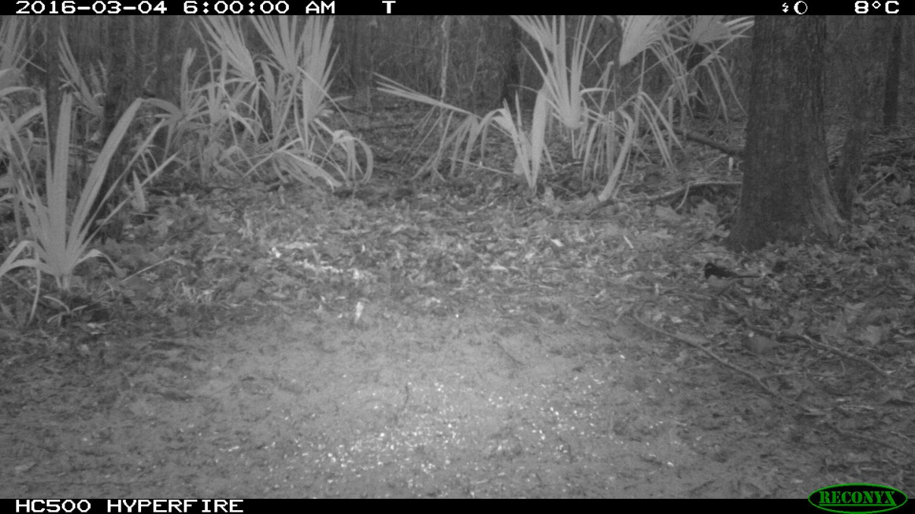
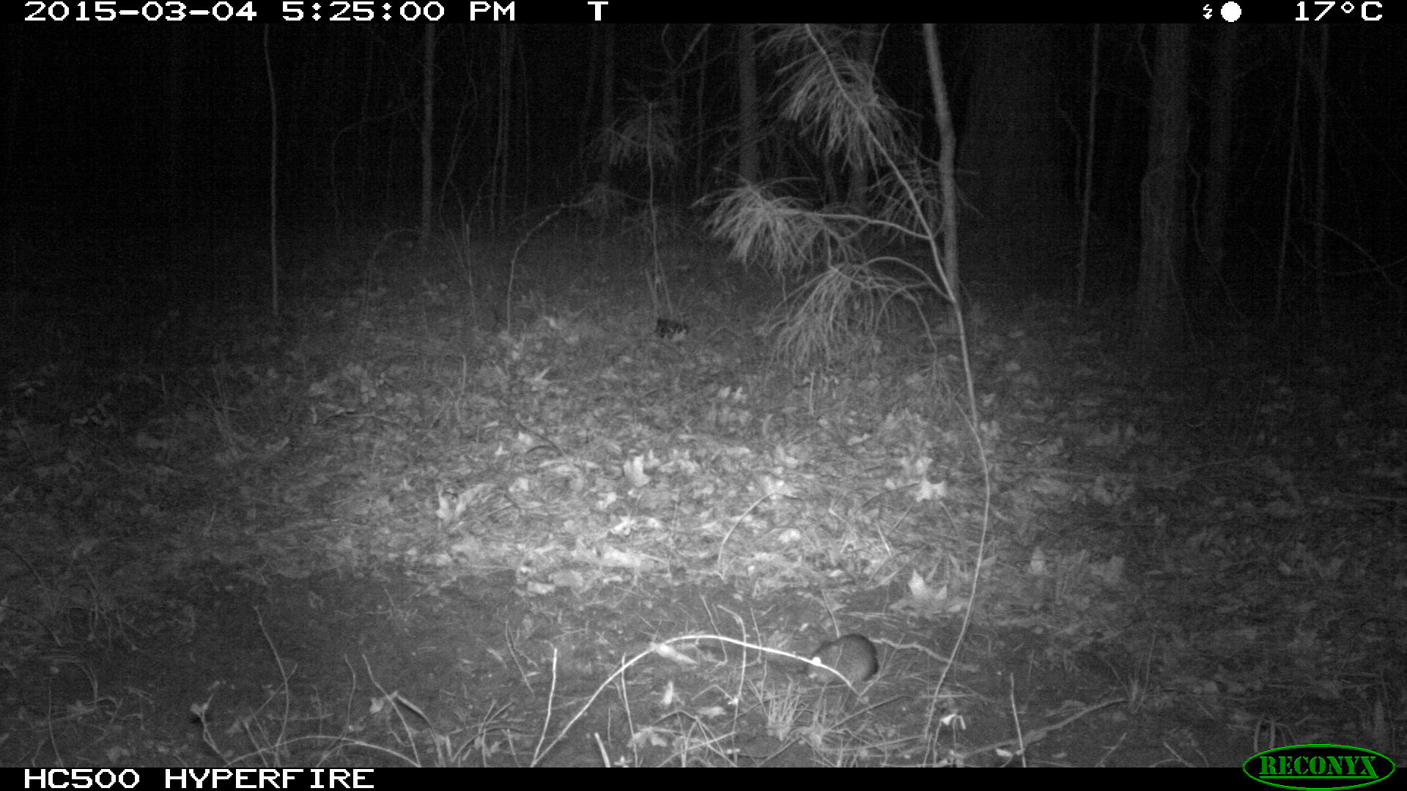
And bycatch

Slide 20
Question
How do different age classes and sexes differ in activity pattern, occupancy, and abundance?
Does that change during and after sounder removals?

